Slide 1
Notable Features of Berry Curvature on Trajectory
Robert McKay

Slide 2
First Feature: k should be dependent on time to exhibit full behavior

Slide 3
When E is constant in x direction….
K_{x} proportional to t
K_{y} constant
K_{z} constant
Implies, the x component of k_{t} x Ω is 0
Conclusion: The x direction is exactly the same with Berry curvature as without
In general, for the Berry curvature case to diverge from the no-Berry curvature case, k should be dependent on time (in orthogonal directions)

Slide 4
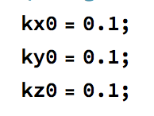
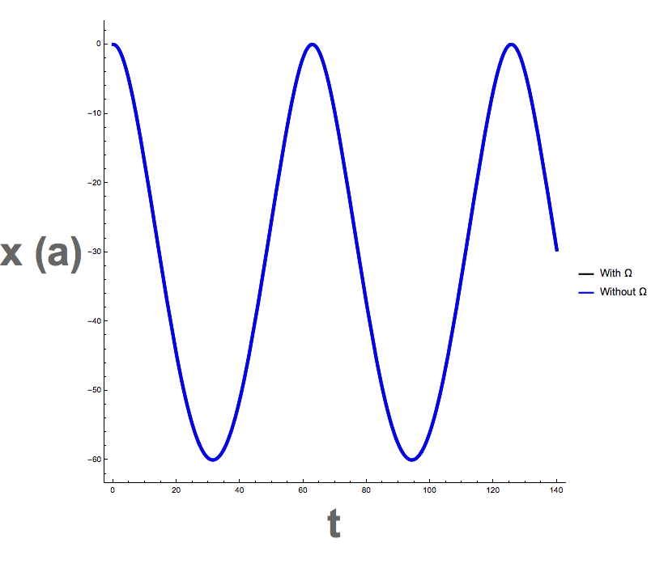
Berry Monopole

Slide 5
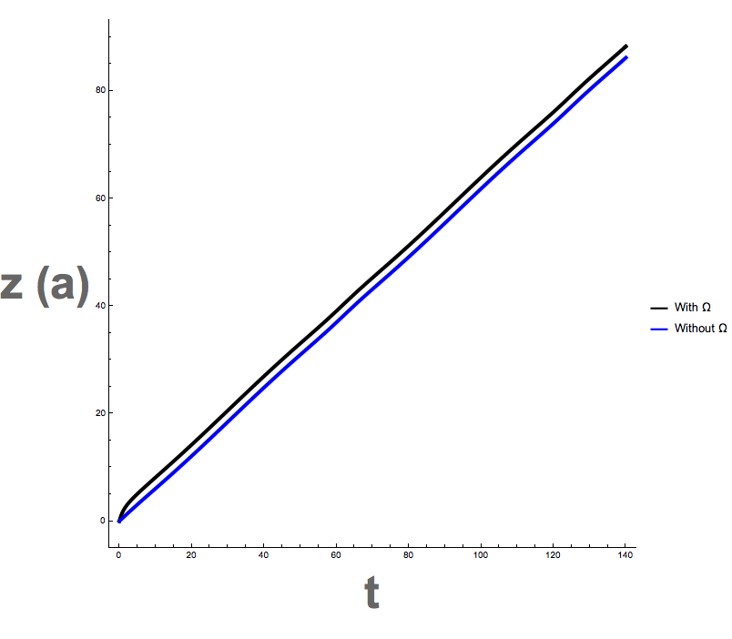
Berry Monopole

Slide 6
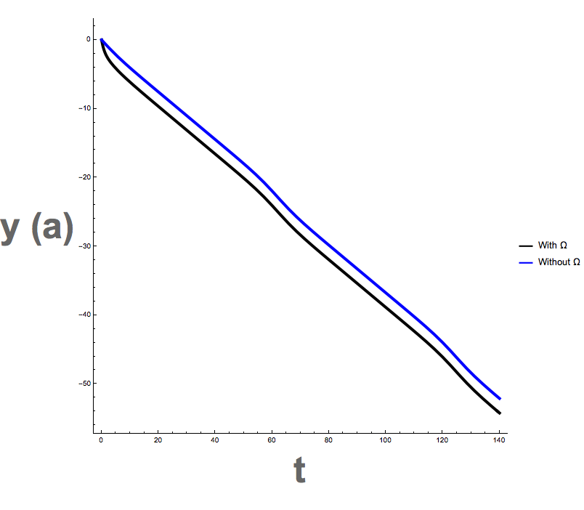
Berry Monopole

Slide 7
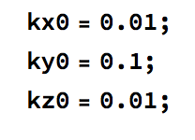

Double Monopole

Slide 8
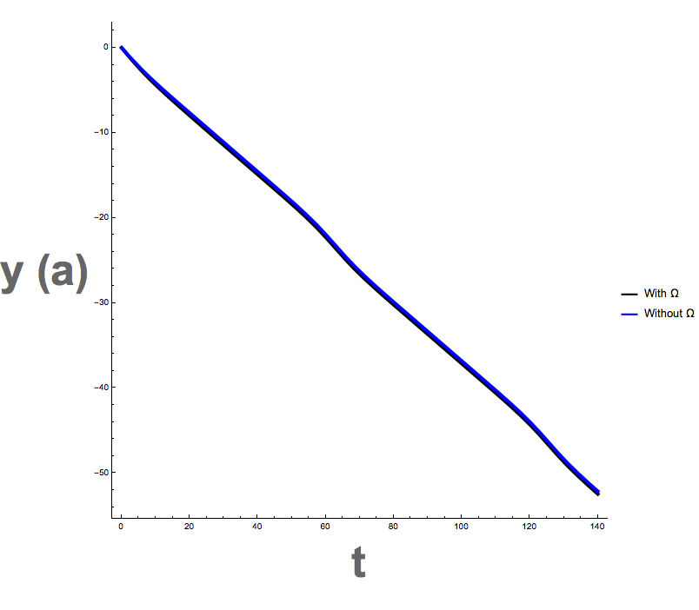
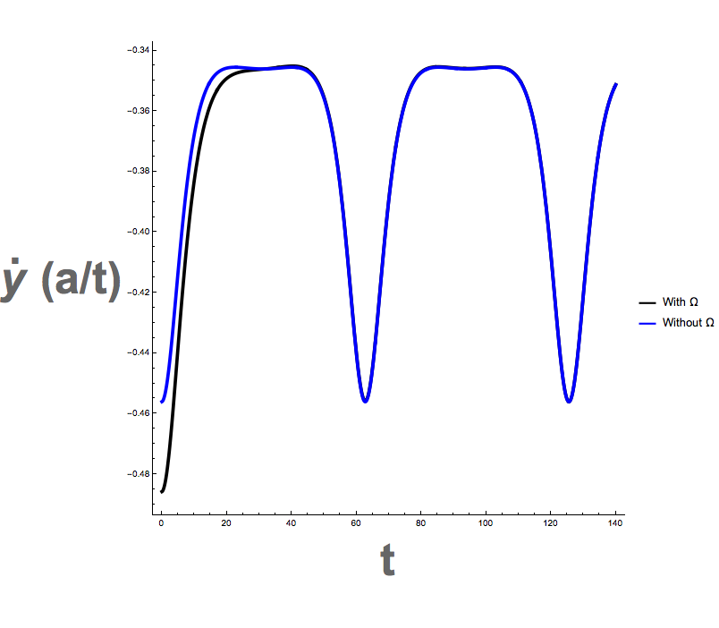
Double Monopole
Note: there is a small deviation in plot #1 (evidence shown in plot #2)

Slide 9
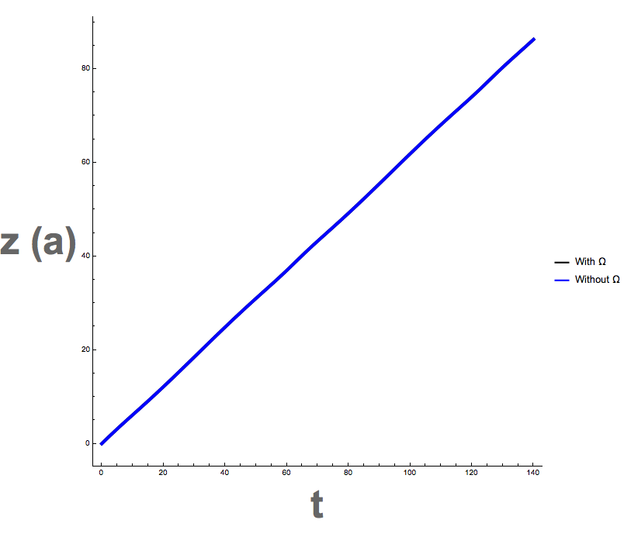
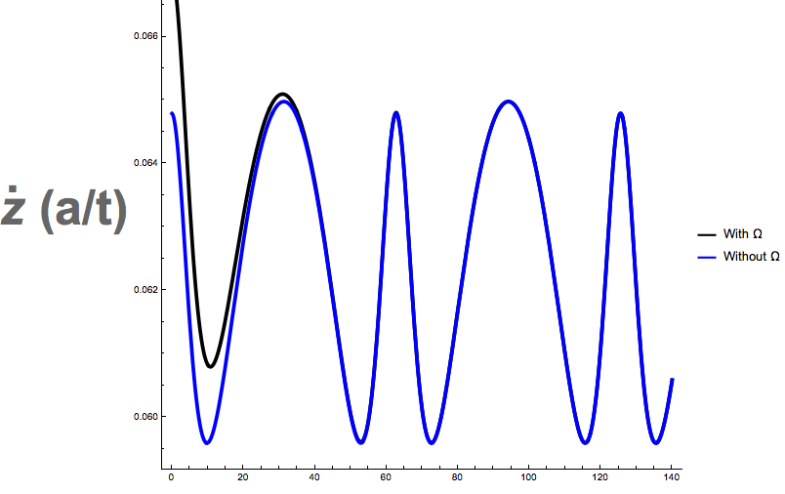
Double Monopole
There is a small deviation in the first plot (evidence shown in plot 2)

Slide 10

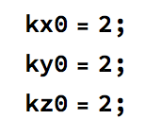
Full Berry Curvature Expression

Slide 11
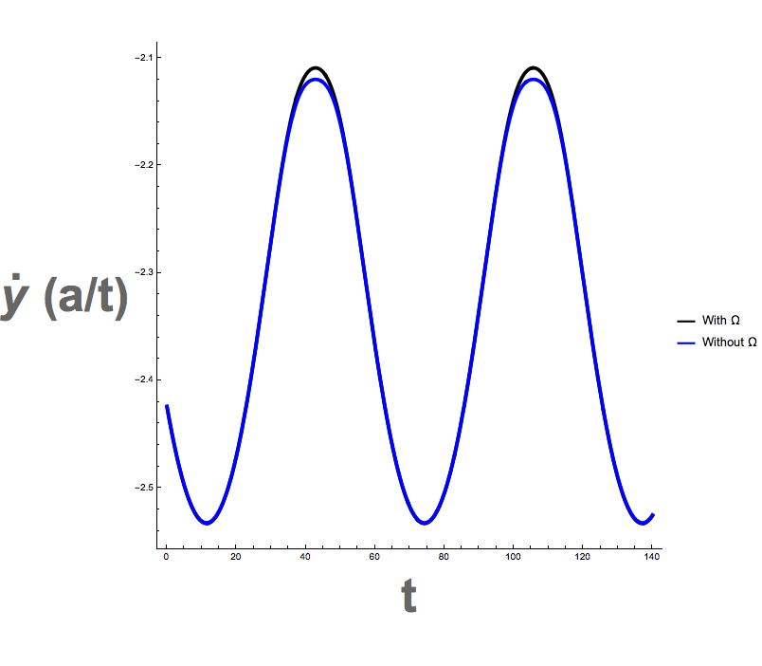
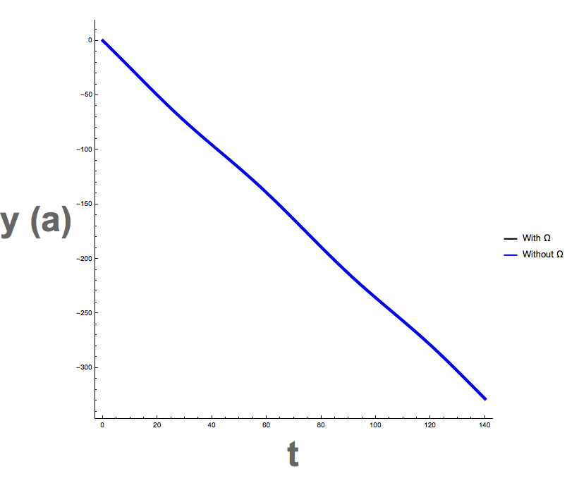
Full Berry Curvature Expression
Note: there is a small deviation in plot #1 as shown in plot #2

Slide 12
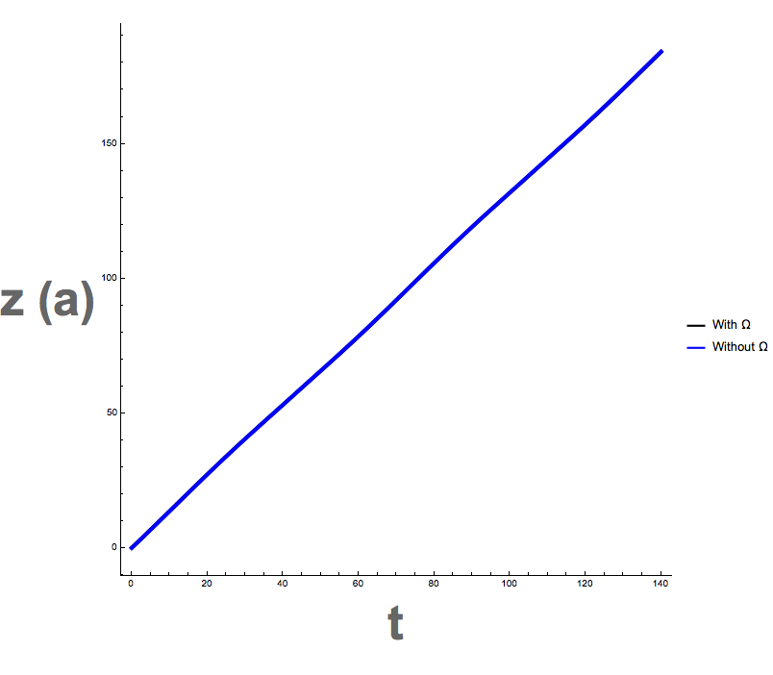
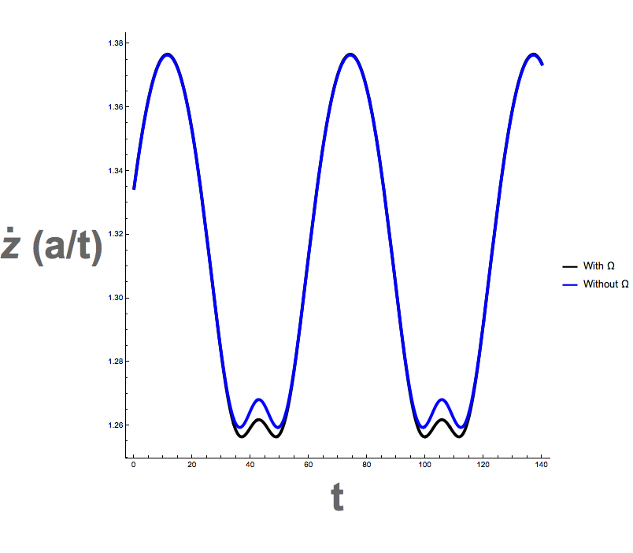
Full Berry Curvature Expression
Note: there is a small deviation in plot #1 as illustrated in plot #2

Slide 13
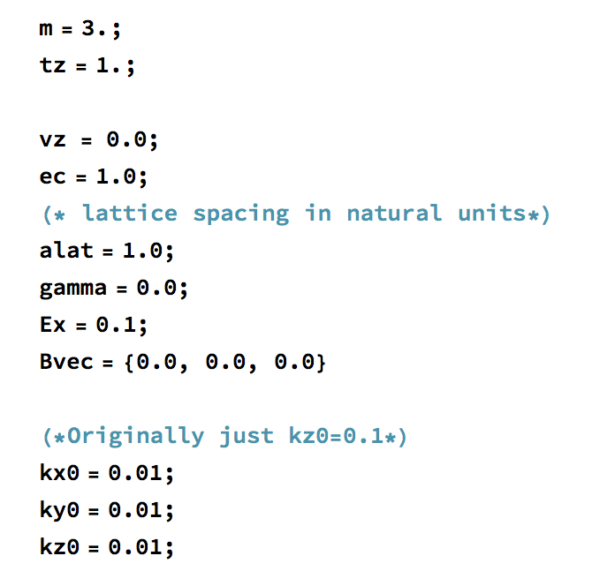
Progression of Trajectories
For convenience, none of the k’s nor dk/dt’s change so I’ve excluded them here. Also, as established before, x and dx/dt do not change either, so they will also be left out.
Initial Conditions:

Slide 14
Features for which to Look Out
The key plots to look at are the dy/dt plot and the kx-ky-kz plot.
The dy/dt will show how picking up Berry curvature terms influences the speed of the electron. Note that the Berry field will not contribute to the momentum gain, since the electric field will interact with the momentum field. Instead, the Berry term contributes to the speed and trajectory terms.
The kx-ky-kz plots will tell you how the Berry field is interacting with the particle. It will show as it traverses in momentum space, it will couple with various elements of the Berry field.

Slide 15
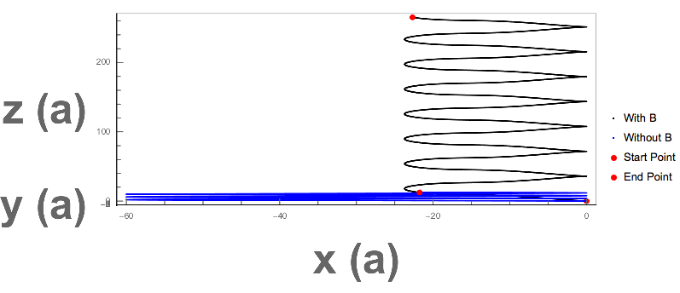
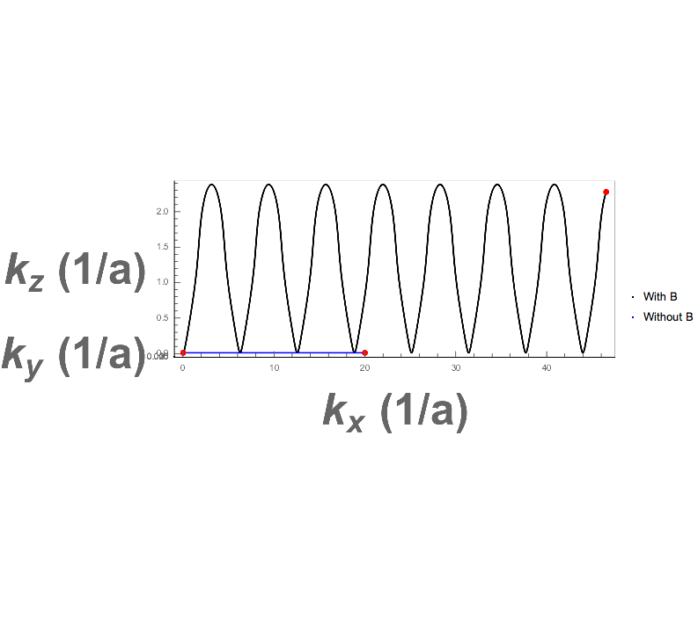
No Curvature

Slide 16
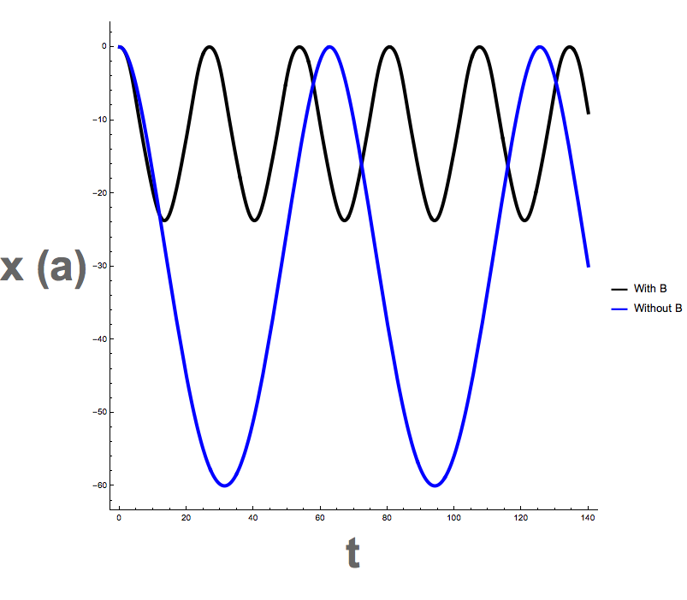
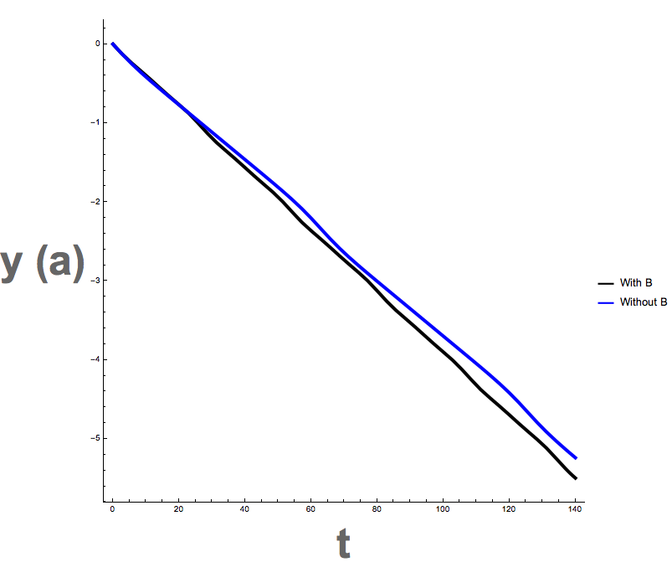
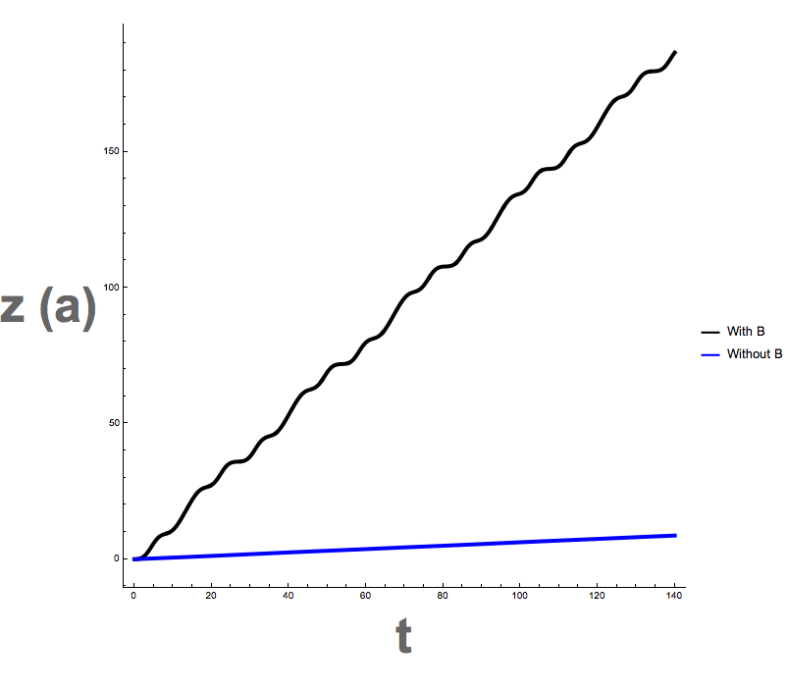
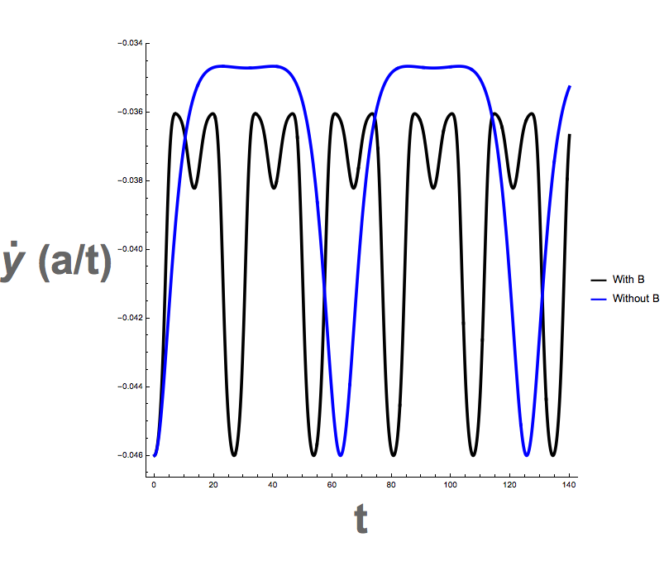
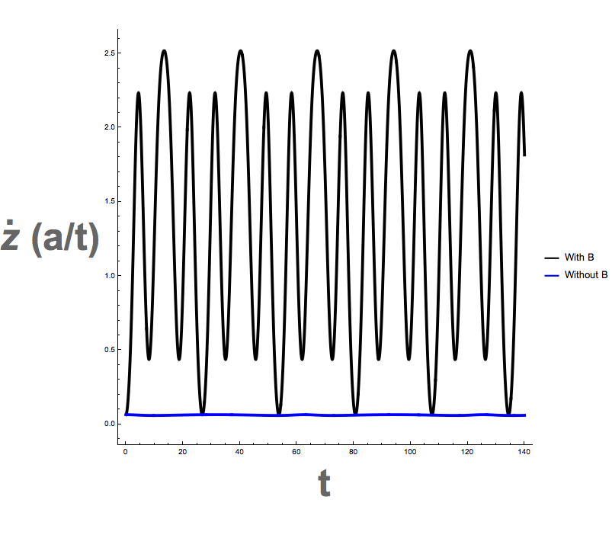
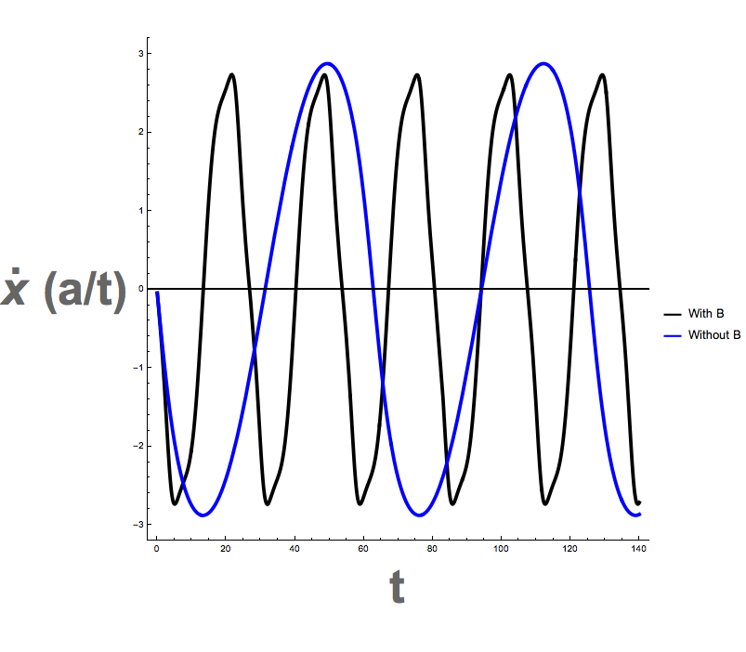
No Curvature

Slide 17
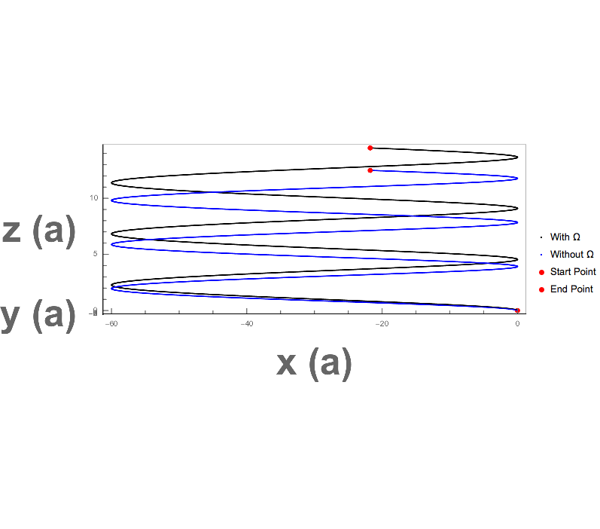
Constant Berry Curvature in + y Dirct.
We see as time progresses, the Berry influence further draws the electron from
It’s classical path.
Next page: the constant Berry term shifts the speed up in the z direction. This makes
Sense since we are adding a constant Berry term, thereby offseting the original speed in
The y cross x direction. We see that the trajectory diverges at a constant rate as a result.

Slide 18
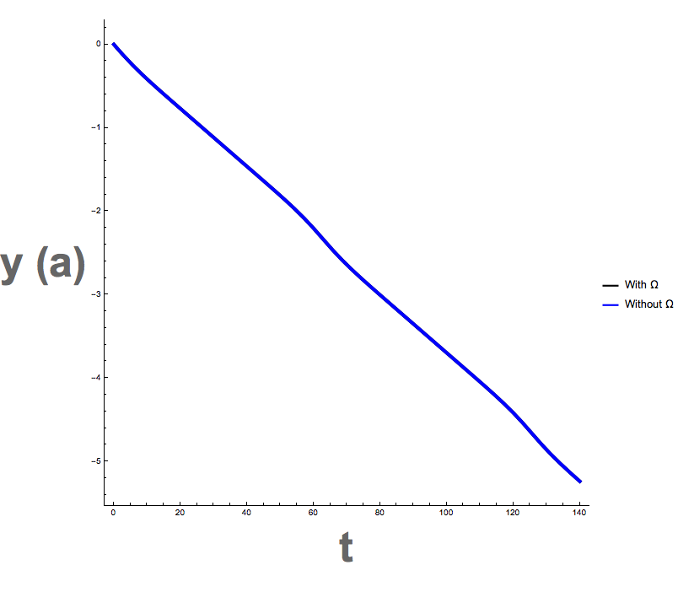
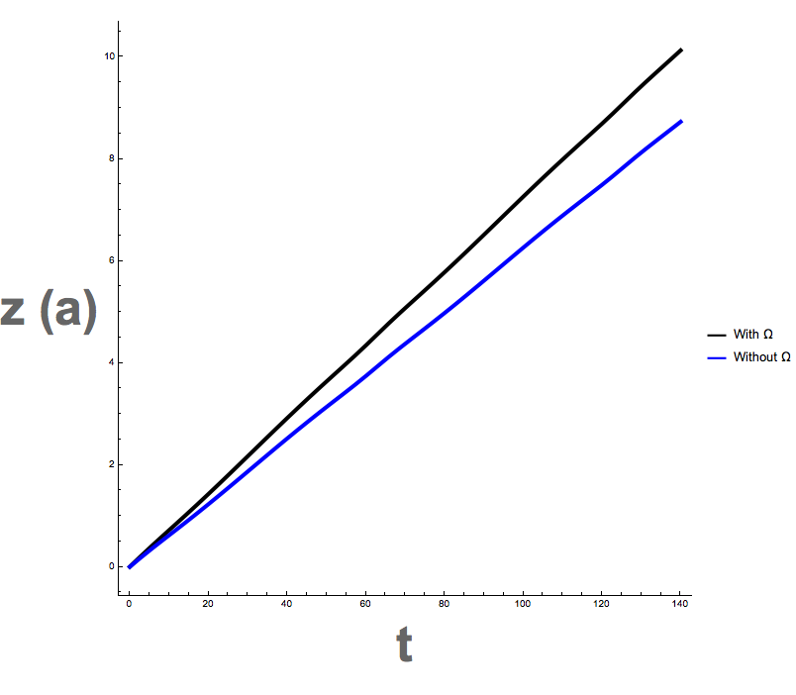
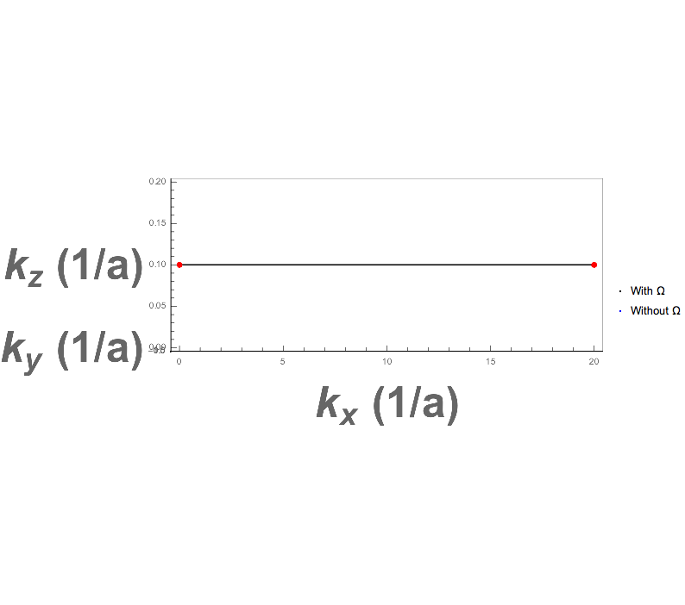
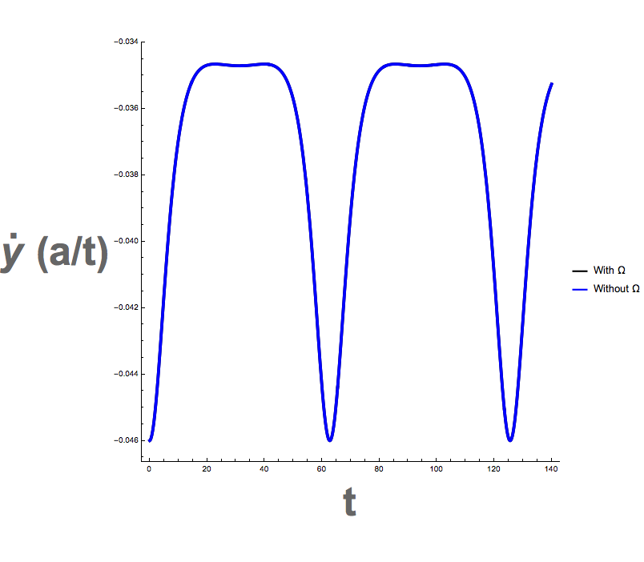
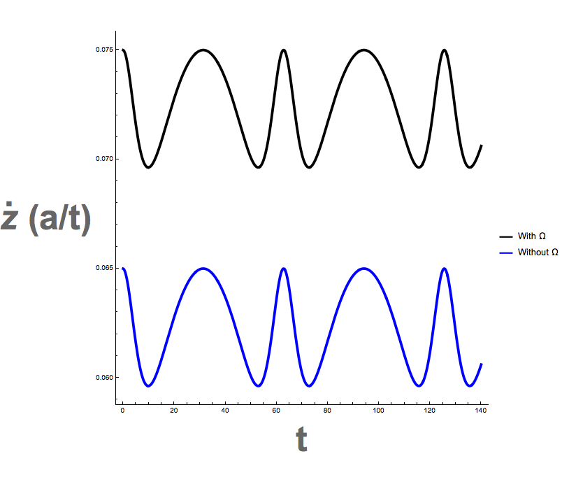
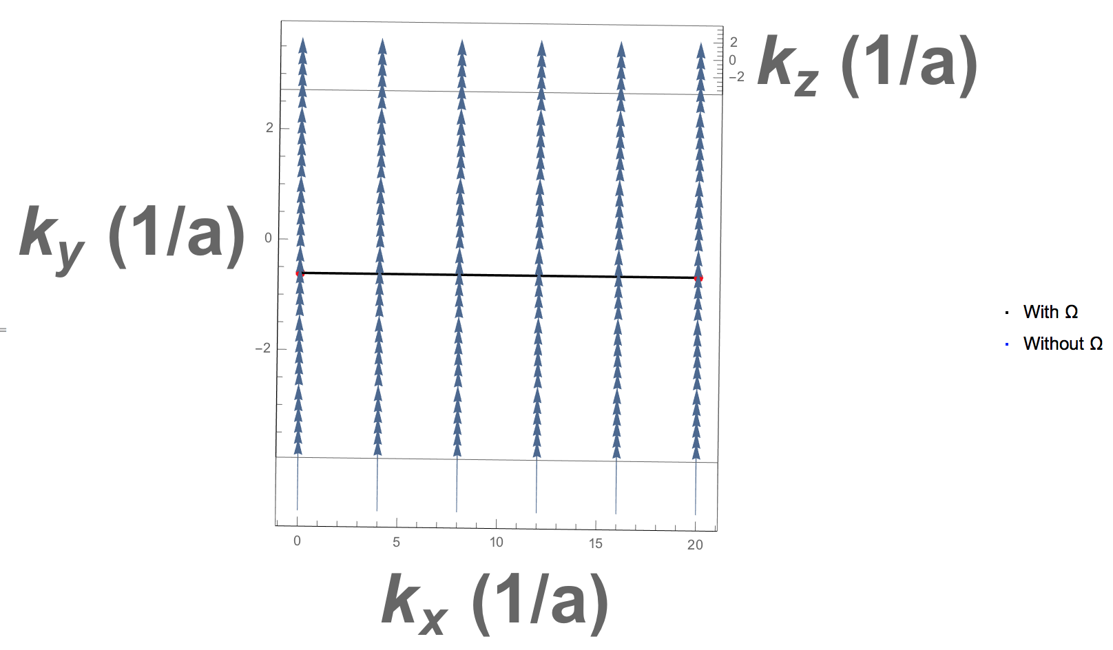
Constant Berry Curvature in + y Dirct.

Slide 19
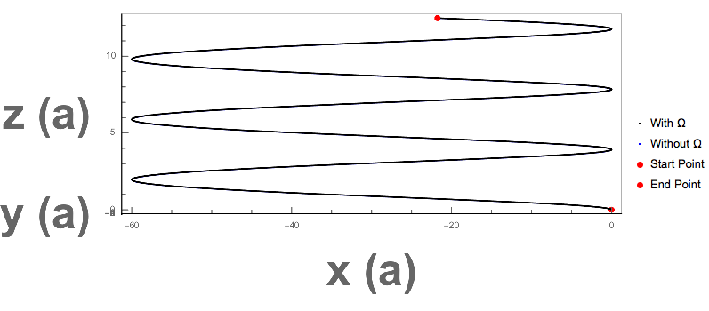
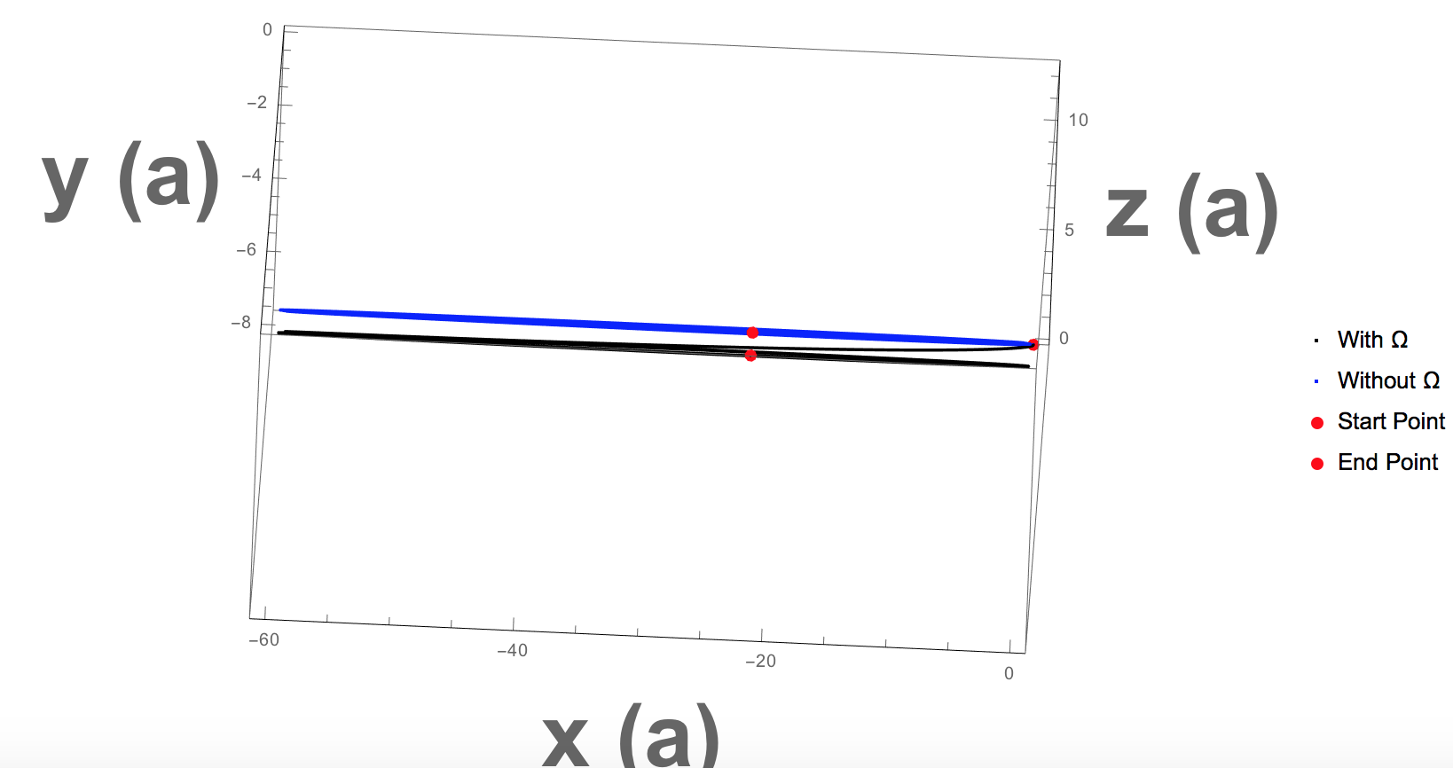
One Monopole of Berry Curvature (at kz=Pi/2)
We now see behavior resembling a monopole. The y speed shows asymtotic divergence, typical near a monopole. We see as time moves on, the electron gets farther away from the monopole and reconverges to the classical behavior (i.e. the monopole ceases adding speed). A similar, those less apparent result occurs in the y direction.

Slide 20
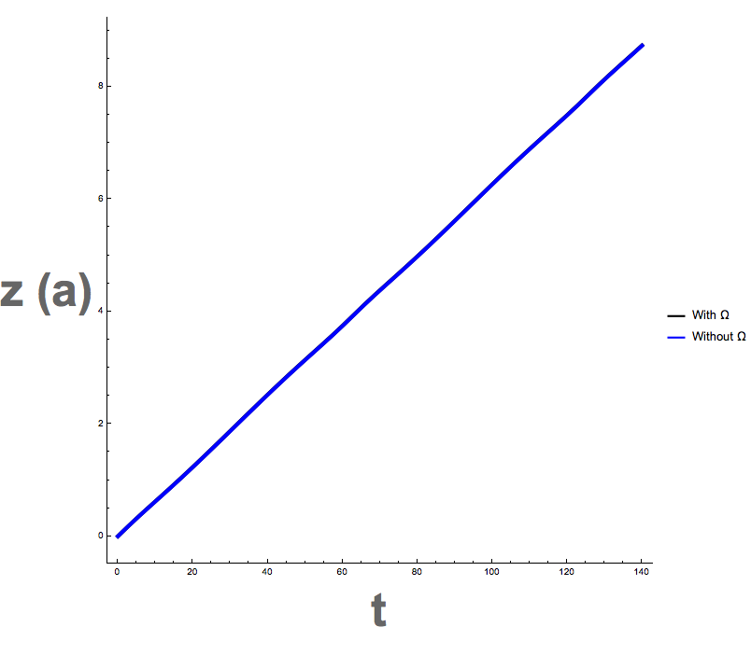
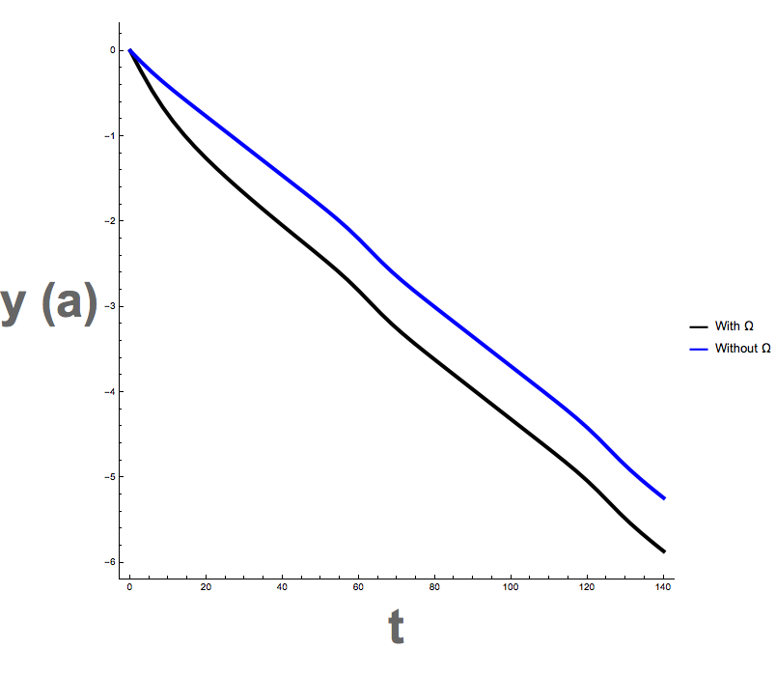
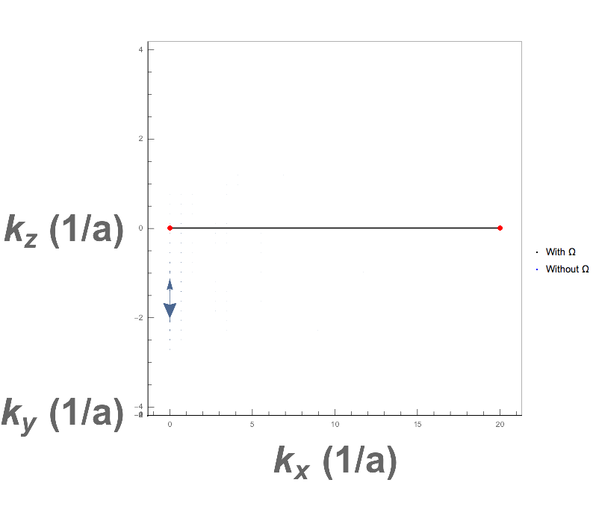
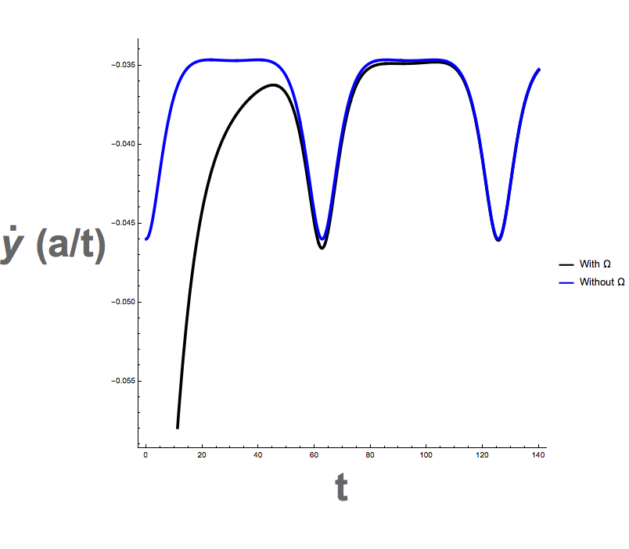
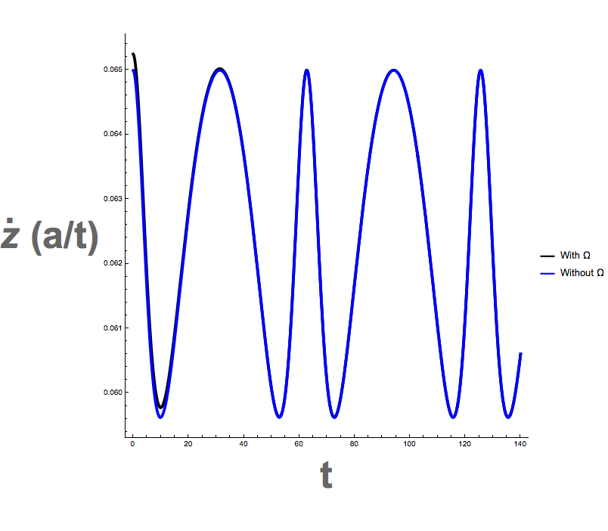
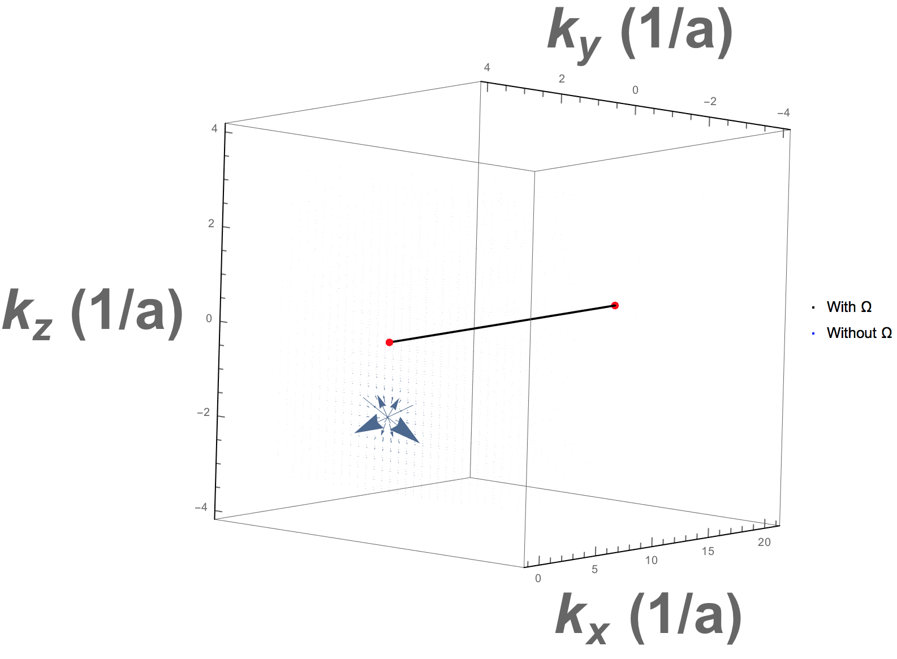
One Monopole of Berry Curvature (at kz=Pi/2)

Slide 21
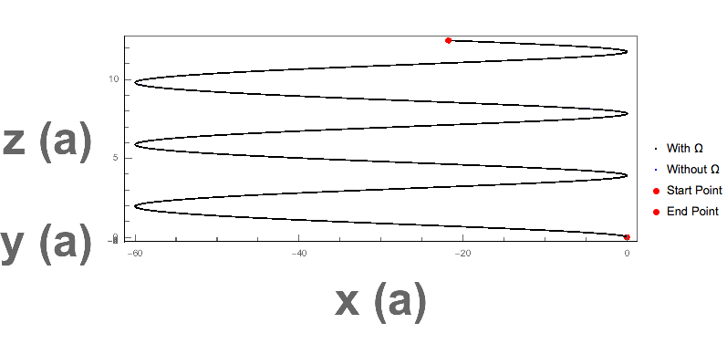
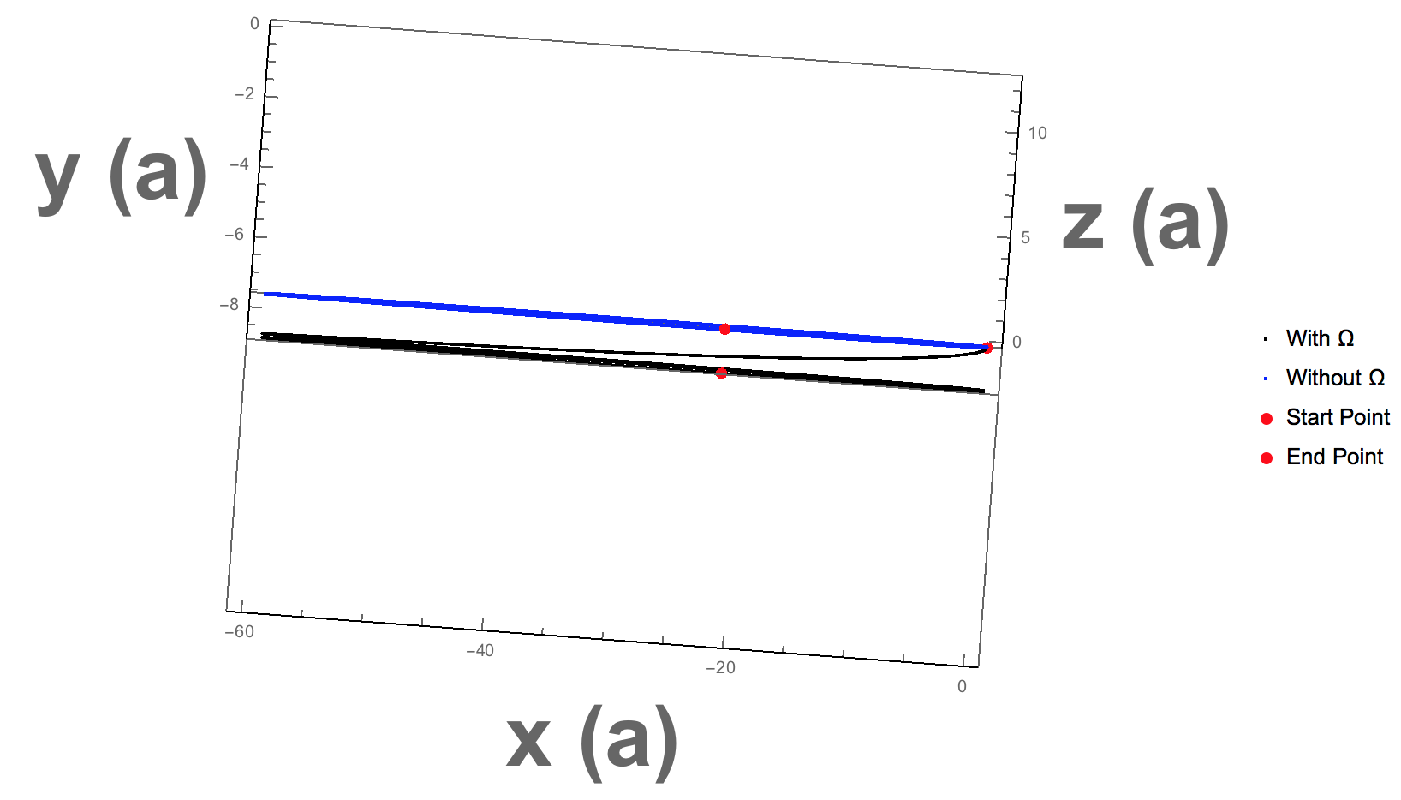
Two Monopoles of Opposite Curvature
Now, we see a stronger response to the Berry field in the y direction. We see it takes longer to reconverge than the monopole and the enhancement lasts longer. Also, there is now no z component divergence. This makes sense as the net Berry field is now in the z direction, and affects the speed in the z cross x direction.

Slide 22
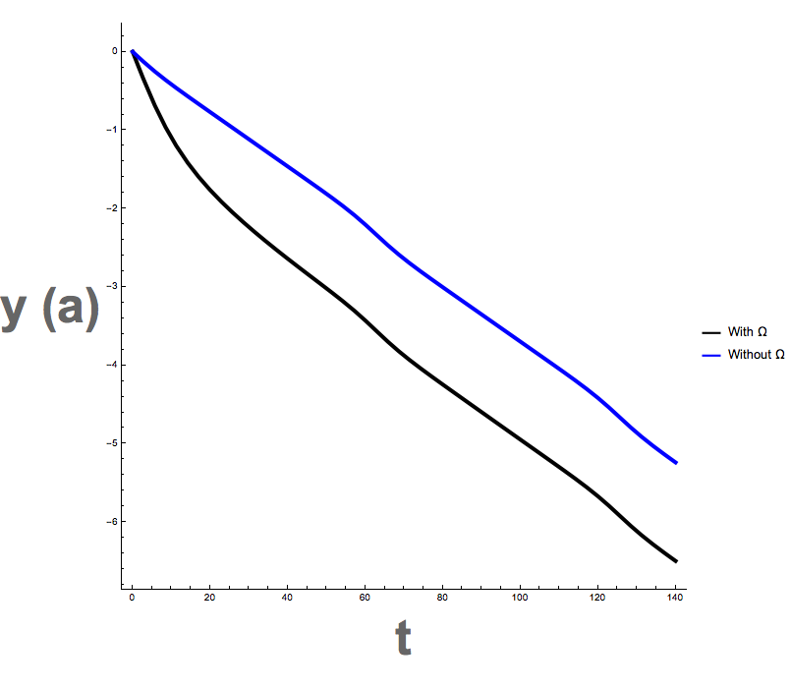

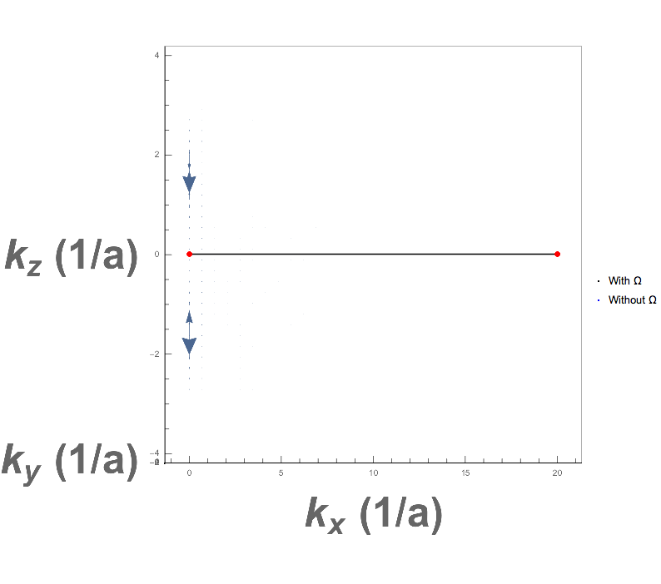
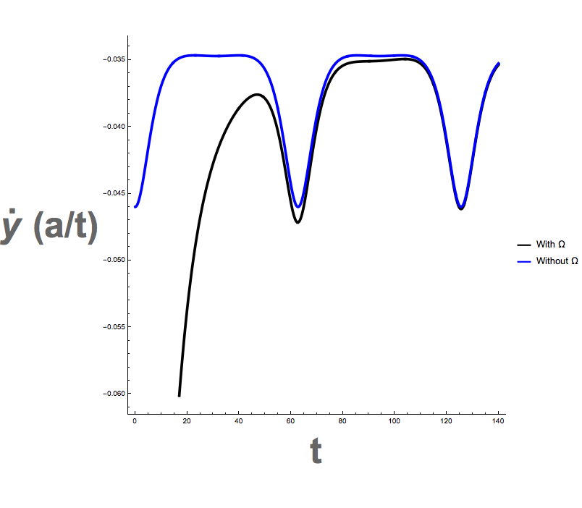
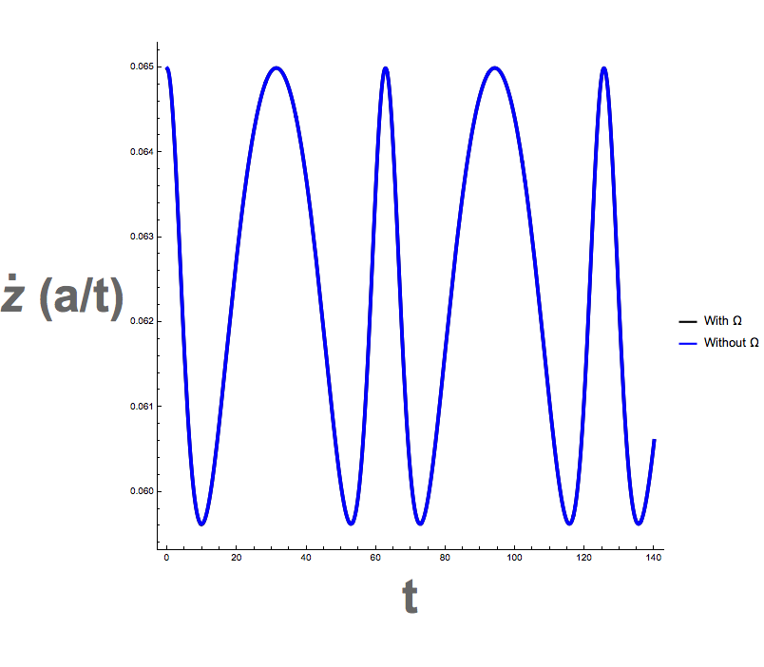
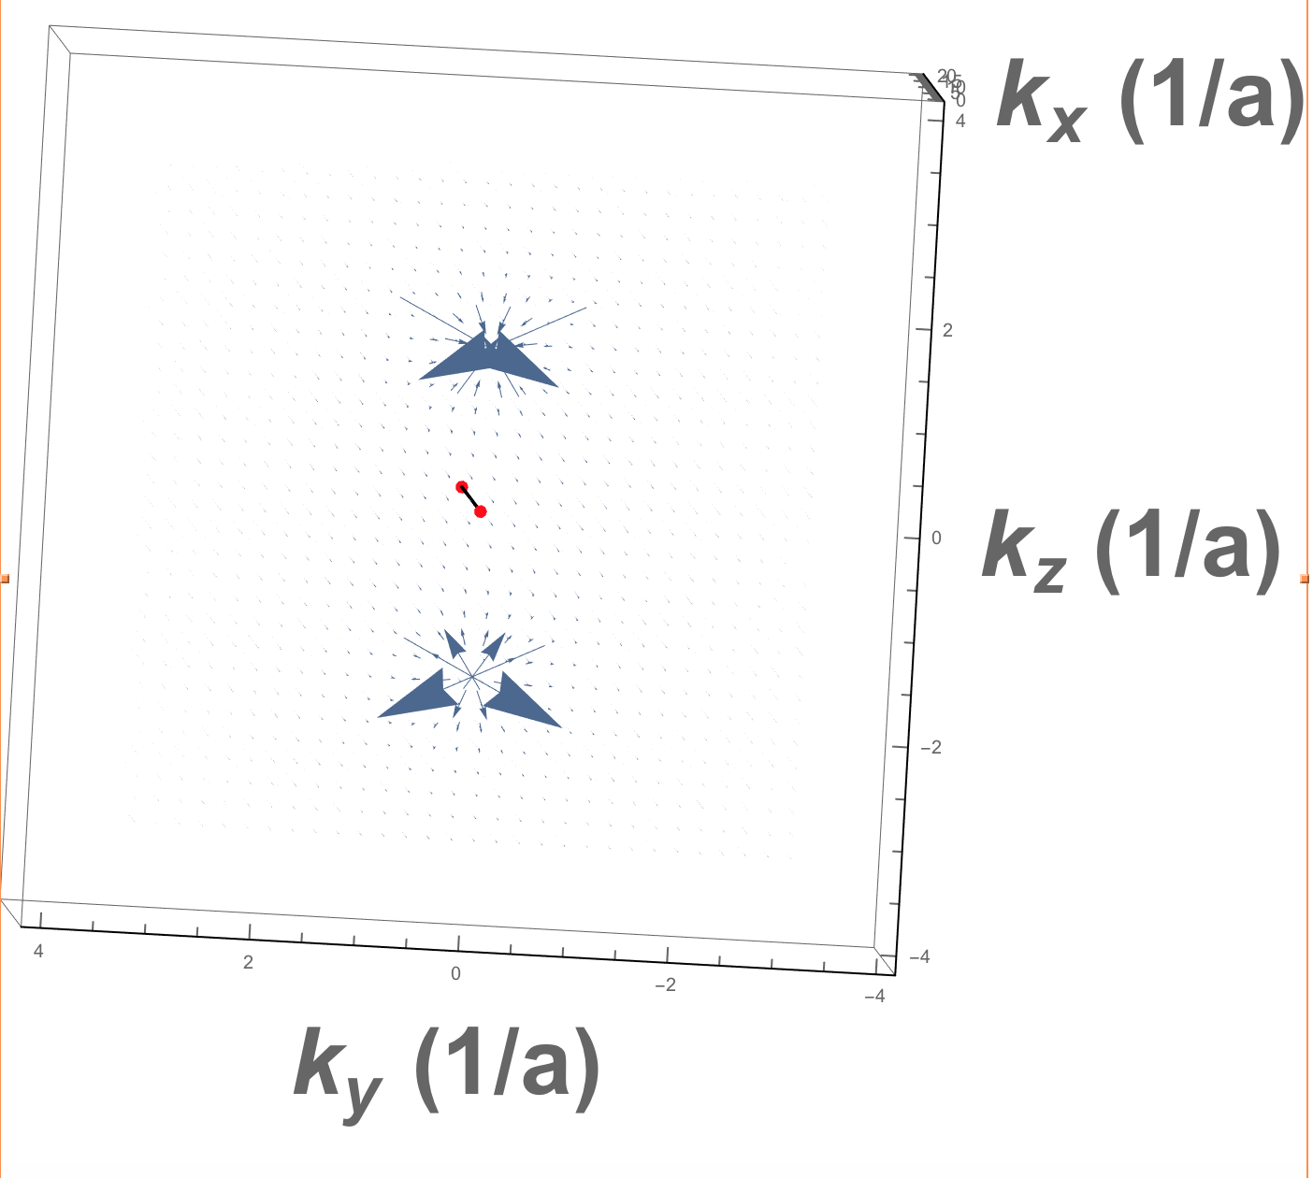
Two Monopoles of Opposite Curvature

Slide 23
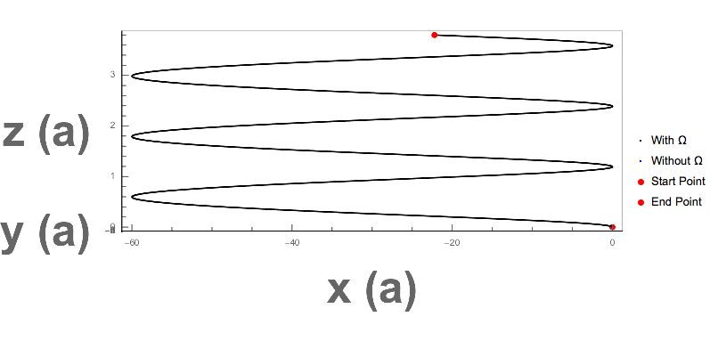
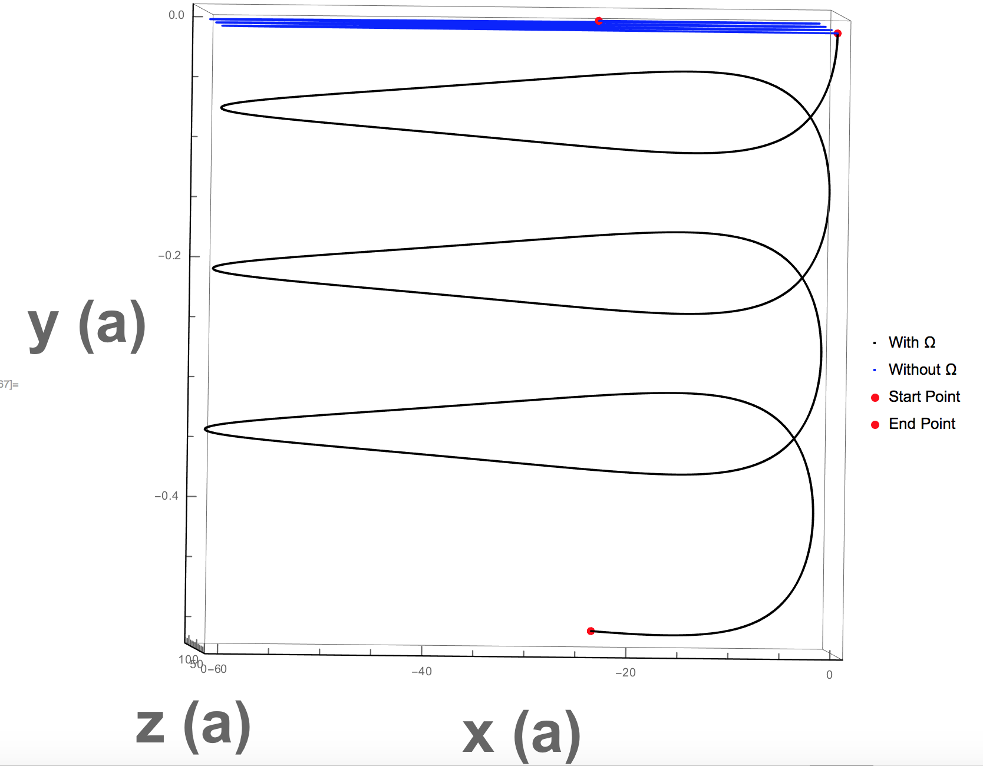
Full Berry Curvature for Type-I WSM
We now see more characteristic behavior of a “pseudo- magnetic field”, by way of orbits. In this final progression, we see the repeating monopoles greatly influencing the speed in the y direction. As the electron approaches the monopoles, we see enhanced effects, and as it moves away, these effects diminish. This is reflected in the trajectory, where we see regions of great divergence, followed by greater divergence, etc. This is due to moving in and out of monopole regions.

Slide 24
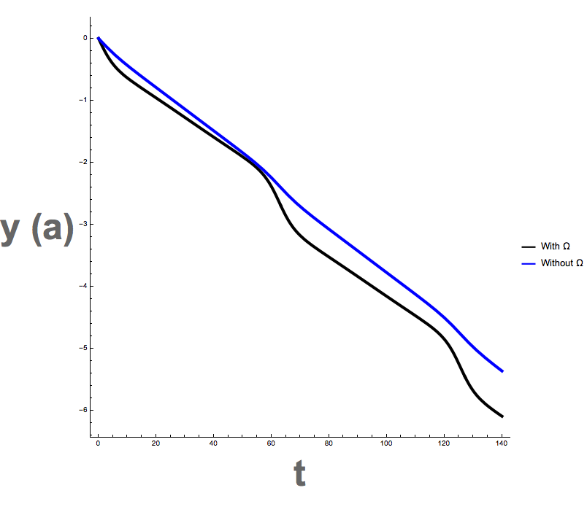

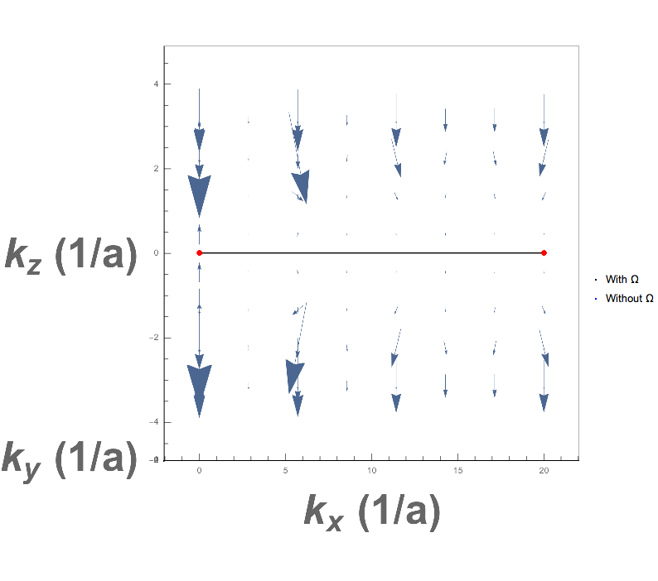
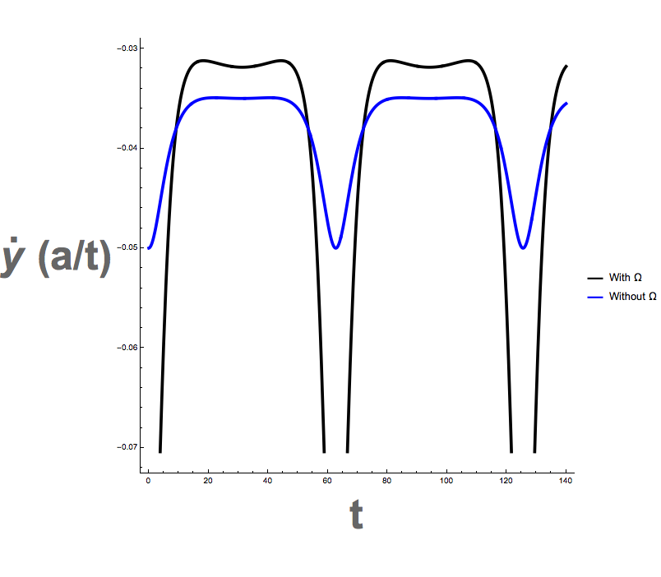


Full Berry Curvature for Type-I WSM

